Slide 1
TCP Client-Server application

Slide 2
Introduction
Transmission Control Protocol (TCP) is a connection-oriented protocol. It provides reliability, flow control, congestion control, and other services.
In TCP, the sockets with type SOCK_STREAM should be generated and used.
The server should create a passive socket and binds a port number to it to listen to connection establishment requests.
Furthermore, the server needs an active socket to exchange the messages between the client and the server.
A connection must be established before data messages exchange.
Both client and server use send() and recv() to send and receive data messages. After sending the last data message, the connection should be concluded, and resources should be released.
Therefore, at the end, the close() method should be used to tear down the connection.

Slide 3
TCP server-side methods
socket() - Create a socket
Bind()
Claims port number to certain socket
listen() or listen([backlog])
Allow the socket to accept requests
Turns the socket into passive
Backlog determines the number of queued requests
accept()
Accept connection
Returns (conn, address)
conn: an active socket (client socket)
Address: the address bond of the client’s socket (request sender)
close()
Finalize the connection (and inform the OS)
The socket will not accept any other operations

Slide 4
TCP client methods
socket() - Create a socket
connect()
Starts three-way handshake
Requests a connection to remote socket
Syntaxsocket.connect(address)
close()
Finalize the connection (and inform the OS)
The socket will not accept any other operations

Slide 5
TCP Server
# creating a TCP socket
SocketS = socket.socket(socket.AF_INET, socket.SOCK_STREAM)
# binding the loopback interface with 6677 port number to the socket
SocketS.bind(("127.0.0.1", 6677))
# converted into passive socket - queue up to 3 requests
SocketS.listen(3)
# accepting the connection,
socketC, add = SocketS.accept()
# finalizing and terminating the connection
socketC.close()

Slide 6
TCP Client
# creating a TCP socket
SocketC = socket.socket(socket.AF_INET, socket.SOCK_STREAM)
# connecting to the server on the specified port port
Socket.connect(("127.0.0.1", 6677))
# finalizing and terminating the connection
socketC.close()

Slide 7
Simple Script - TCP connection
Server
import socketsock_p = socket.socket(socket.AF_INET,socket.SOCK_STREAM)
sock_p.bind(("127.0.0.1", 49999))
sock_p.listen(2)
sock_a, sockname = sock_p.accept()
print('Accepted request from', sockname[0] ,'with portnumber', sockname[1])
sock_a.close()
Client
import socketsocket_c = socket.socket(socket.AF_INET,socket.SOCK_STREAM)
socket_c.connect(("127.0.0.1", 49999))
print("The request has been sent")
socket_c.close()

Slide 8
send()
Sends data to a socket
socket.send(bytes[, flags])
Returns number of bytes sent
Example:
clientsocket.send(str(List).encode())

Slide 9
recv()
Receive data from the socket
socket.recv(bufsize[, flags])
Bufsize: is permitted amount of data to be read
Example:
List = Socket.recv(1024)

Slide 10
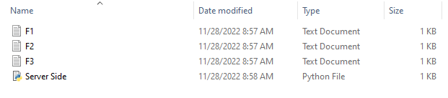
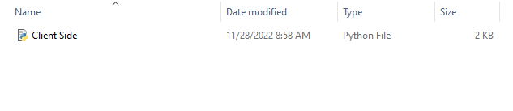
Assignment question
Write two Python scripts (client and server) that implement TCP to communicate over the network. The client, on the other hand, establishes a connection with the server and sends several requests. The server, on the other hand, can list local files at a folder (the folder is available on the server side) and provide the list of files, and read text file contents and send them to the client.
Firstly, you need to have client side (folder) and server side (folder)
Secondly, create 3 text files and name them F1.txt, F2.txt, and F3.txt. You are free to choose the text files contents.
Server side will have Python script for the server and the three text files that you have already created earlier.
Client side (folder) will have Python script for the client.

Slide 11
When you run the codes, the client will initiate a connection with the running server.
The menu should appear on the client side with three options:
1. Send a list of the text files that are currently available on the server folder.
2. Select a file to be copied to the client side by its name.
3. Quit and print goodbye message.
Option1
The server will respond by sending a list of the text files available in his side (This list should be updated).
Option2
The client will request a copy of any text file from the server by entering the file name. As a result of this request, a copy of the same file will appear on the client side with the same content. No need to print the content of text files on the console screen.
Option3
The servers should keep running and listening to the client request until the client selects this option.

Slide 12
Client-side code
While loop to keep the user entering the option number he wants to execute
For each option, send(option#.encode) function is used to send the user selection to the server
For each option, recv() function is used to receive a list of available files on the server to the client.
For option 2, send(filename.encode) function is used to send the user selection of the file he wants to copy from the server.
For option 2, recv() function is used to receive a copy of the selected file from the server.

Slide 13
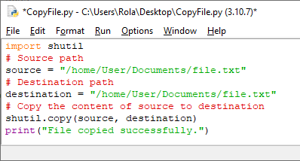
Server-side code
keep listening for requests
Send the list of local files to the client (to select from)
Send the file to the client.
Quit when it receives “quit” message from the client
For option 1, the server uses the send() function to send a list of the .txt files he has.
You are free to use any method to do this (e.g., glob module, os.listdir())
glob.glob (‘C:\Users\Rola\Desktop\ITCE352\LAB3\Server.*’)
glob.glob(‘*.txt’)
For option 2, the server uses the recv() function to receive the file name from the client and then sends the file to the client using copy method

